Slide 1
Booth Multiplication Algorithm

Slide 2
Booth Algorithm
An efficient way to multiply two signed binary numbers expressed in 2's complement notation :
Reduces the number of operations by relying on blocks of consecutive 1's
Example:
Y × 00111110 = Y × (2⁵+2⁴+2³+2²+2¹).
Y × 00111110 =Y × (01000000-00000010) = Y × (2⁶-2¹). One addition and one subtraction

Slide 3
Another Eg:
Search for a run of ‘1’ bits in the multiplier
  E.g. ‘0110’ has a run of 2 ‘1’ bits in the middle
  Multiplying by ‘0110’ (6 in decimal) is equivalent to multiplying by 8 and subtracting twice, since 6 x m = (8 – 2) x m = 8m – 2m (2^{k+1}-2^{m) where k =3 and m=1}

Slide 4
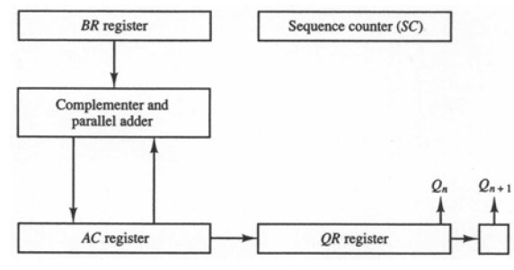
Description and Hardware for Booth Multiplication
QR multiplier
Q_{n} least significant bit of QR
Q_{n+1} previous least significant bit of QR
BR multiplicand
AC 0
SC number of bits in multiplier
Algorithm
Do SC times
Q_{n}Q_{n+1} = 10
AC ← AC + BR + 1
Q_{n}Q_{n+1} = 01
AC ← AC + BR
Arithmetic shift right AC& QR
SC ← SC – 1

Slide 5
For our example, and multiply (-9) x (-13)
  The numerically larger operand (13) would require 4 bits to represent in binary (1101). So we must use AT LEAST 5 bits to represent the operands, to allow for the sign bit.

Slide 6
Solution 2 - Booth’s Algorithm (1)…….
START
M
A
Q
Q₋₁
A ←0, Q₋₁ ←0
M ← Multiplicand
Q ← Multiplier
Count ← n
Q₀, Q₋₁
= 10
= 01
A ← A - M
=00
=11
A ← A + M
Arithmetic shift right: A, Q, Q₋₁
Count ← Count - 1
Count=0?
No
Yes
END

Slide 7
Booth’s Algorithm(2)…..
Scan the bit and right of the bit of the multiplier at the same time by control logic
If two bits =00 =11 - right shift only (A,Q,Q₋₁) =01 A A +M and right shift =10 A A - M and right shift
To preserve the sign of the number in A and Q, arithmetic shift is done (A_{n-1} is not only shifted into A _{n-2} but also remains in A _{n-1})

Slide 8
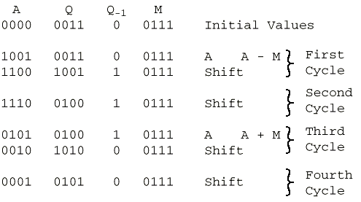
Example of Booth’s Algorithm(3)….

Slide 9
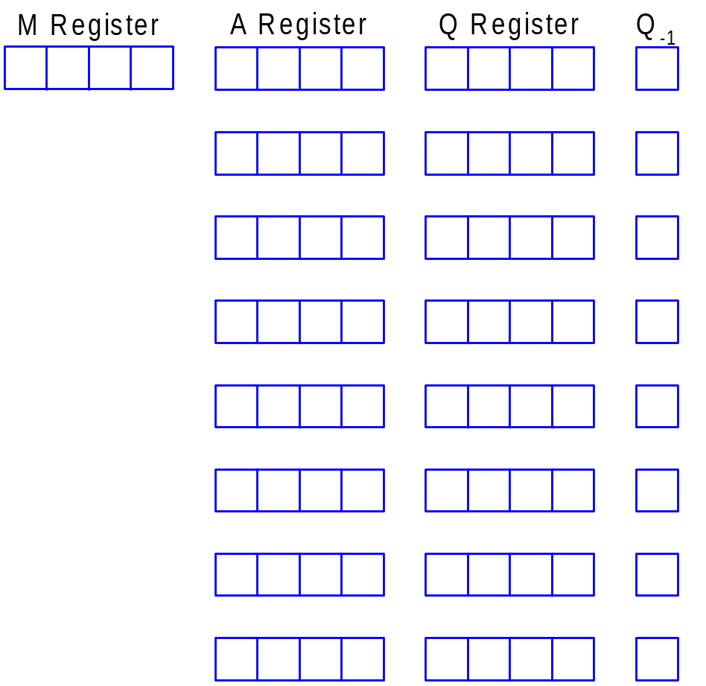






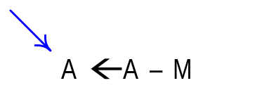

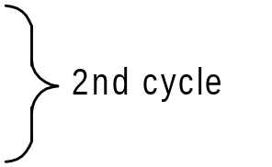



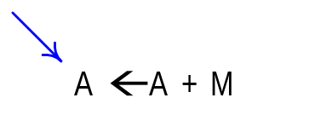

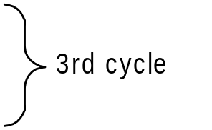


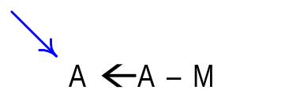

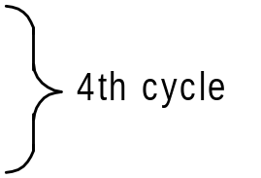


Slides adapted from tan wooi haw’s lecture notes (FOE)
M=0101, Q=1010 , - M = 1011
Consider the multiplication of 5 x -6, both represented in 4-bit twos complement notation, to produce an 8-bit product
N/B: Negate the product if sign bit of product is negative, 1
Negate 11100010
1’ = 00011101
2’ = 00011110 (30)
Since sign bit is 1, it shown that it is a negative value,
Therefore product = -30

Slide 10


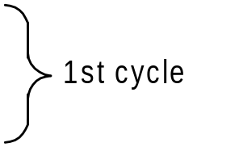








Slides adapted from tan wooi haw’s lecture notes (FOE)
M=1010, Q=1001 , - M = 0110
Consider the multiplication of -6 x -7, both represented in 4-bit twos complement notation, to produce an 8-bit product
Product = 00101010
Since the sign bit is positive , 0.
Therefore the product value is 42

Slide 11
Flowchart for Booth Multiplication
Multiply
Example: -9 × -13 = 117
BR = 10111, BR + 1 = 01001
Multiplicand in BR
Multiplier in QR
Comment
AC
QR
Q_{n+1}
SC
00000
10011
0
5
AC ← 0
Q_{n+1} ← 0
SC ← n
Subtract BR
01001
01001
Ashr
00100
11001
1
4
Ashr
00010
01100
1
3
= 10
= 01
10111
Q_{n}Q_{n+1}
Add BR
11001
AC ← AC + BR + 1
= 00
AC ← AC + BR
Ashr
11100
10110
0
2
= 11
Ashr
11110
01011
0
1
Subtract BR
01001
ashr (AC & QR)
SC ← SC – 1
00111
Ashr
00011
10101
1
0
≠ 0
= 0
SC
END

Slide 12

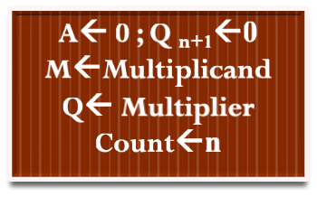






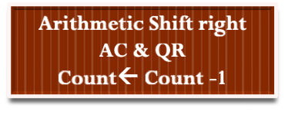

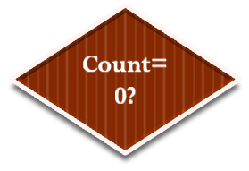


Multiply 7 x 3 using above signed 2's compliment binary multiplication.
Multiplicand =7 → Binary equivalent is 0111→M
Multiplier = 3 → Binary equivalent is 0011→Q
-7 → Binary equivalent is 1001→ -M
A
0000
A
0101
-M
1001
M
0111
A
1001
A
0010
=10
Step
A
Q
Q_{n+1}
Action
Count
1
0000
0011
0
Initial
4
2
1001
0011
0
A←A-M
2
1100
1001
1
Shift
3
3
1110
0100
1
Shift
2
4
0101
0100
1
A←A+M
4
0010
1010
0
Shift
1
5
0001
0101
0
Shift
0

Slide 13
Examples
Multiply the following using Booth’s algorithm
  7 x -3
  -7 x 3
  -7 x -3
  11 x 13
  -11 x 13
  11 x -13
  -11 x -13

Slide 14
Reference
Morris Mano, “Computer System Architecture”, Pearson Education, 3rd edition (Chapter 10)

